Slide 1

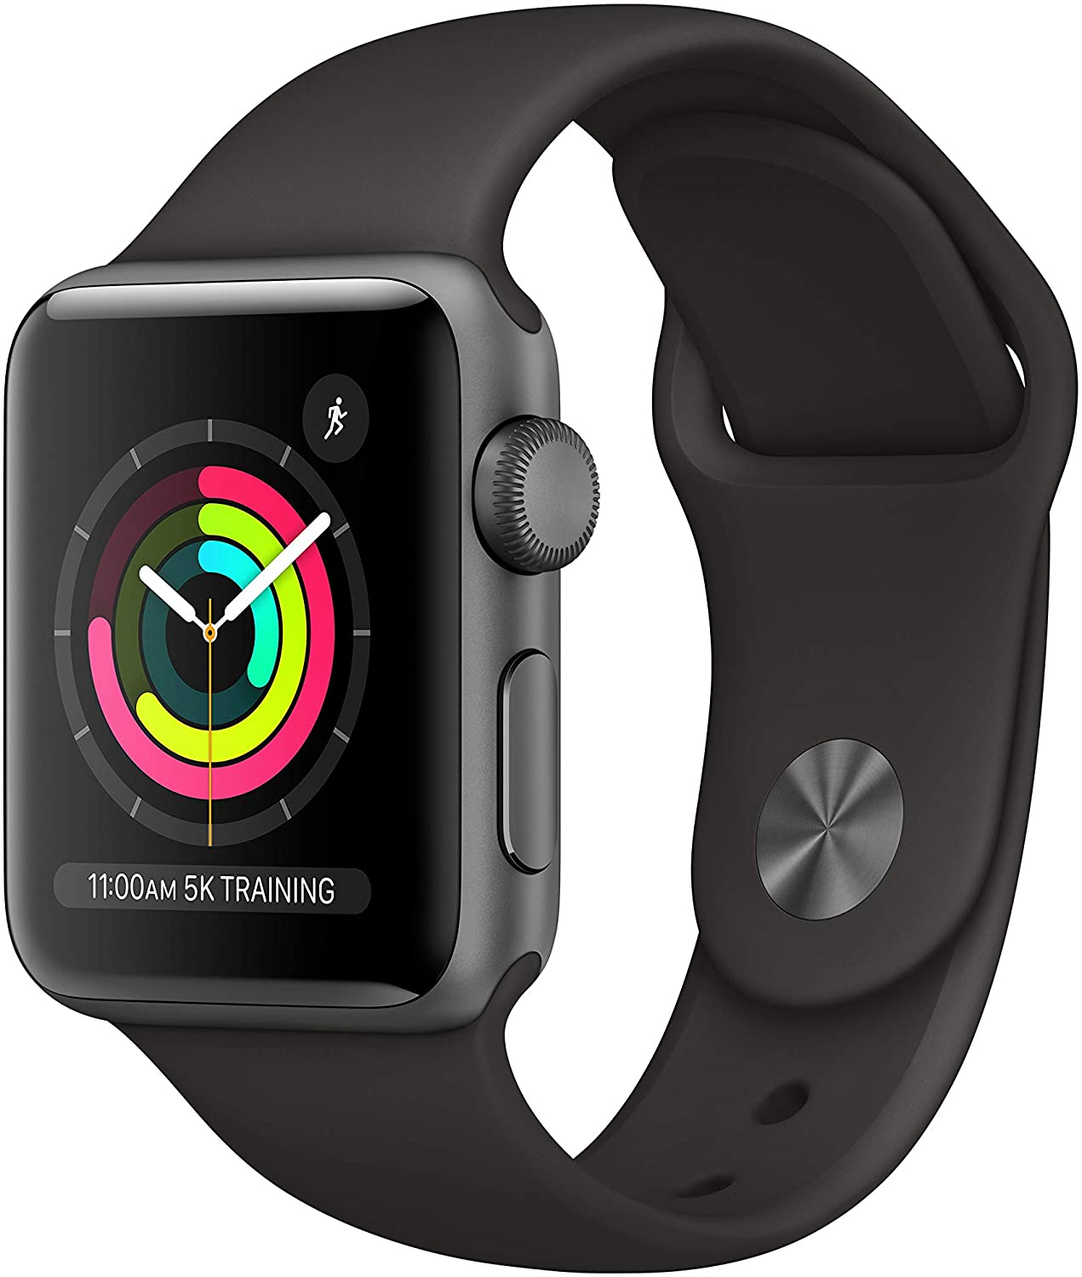
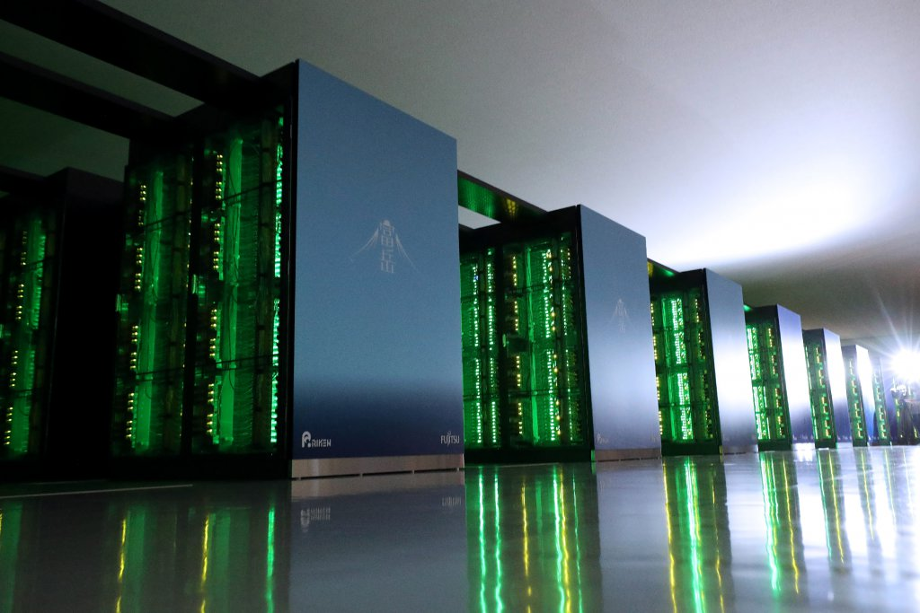

CSE113: Introduction to Parallel and Concurrent Programming
January 9, 2023
https://techwireasia.com/2020/06/japans-fugaku-is-the-worlds-fastest-supercomputer/ https://www.lenovo.com/
https://www.apple.com

Slide 2
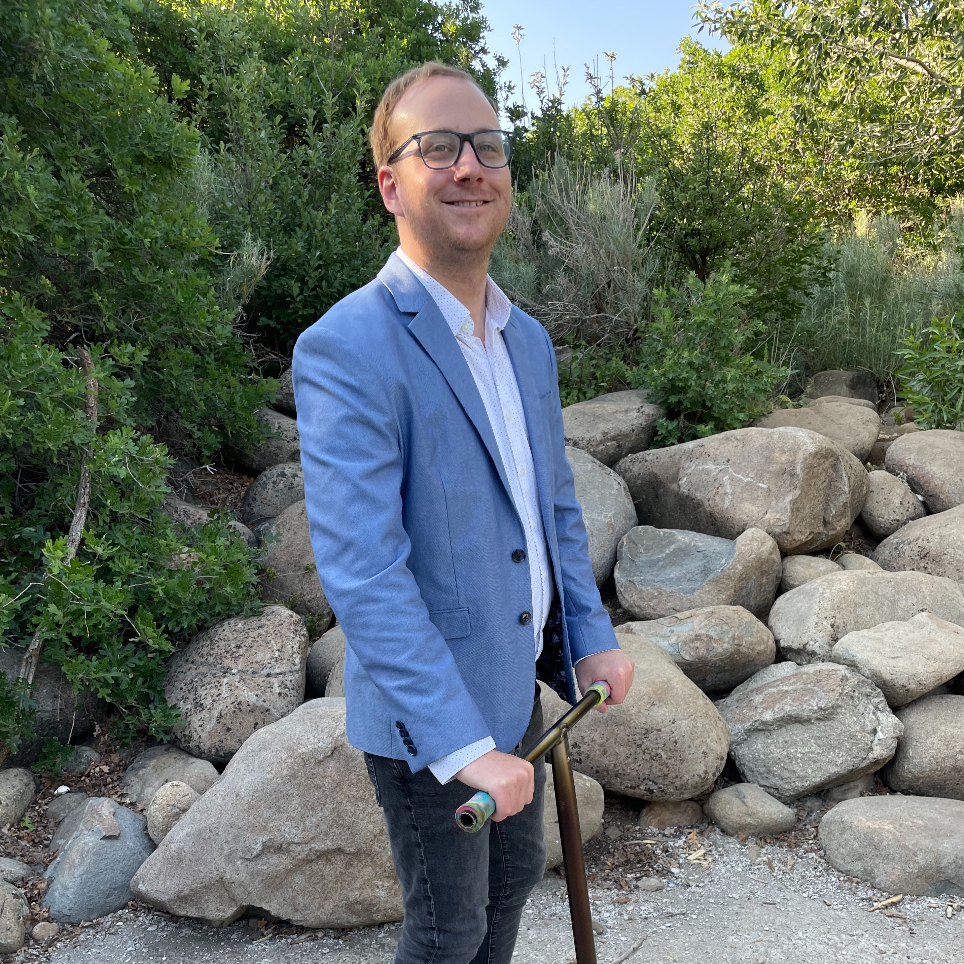
Hello!
Professor Tyler Sorensen (he/him)
Call me Tyler!
Faculty at UC Santa Cruz Since Summer 2020
Third time teaching this class!
Previously
Post doc at Princeton
PhD Student at Imperial College London
BS/MS at University of Utah
https://users.soe.ucsc.edu/~tsorensen/

Slide 3


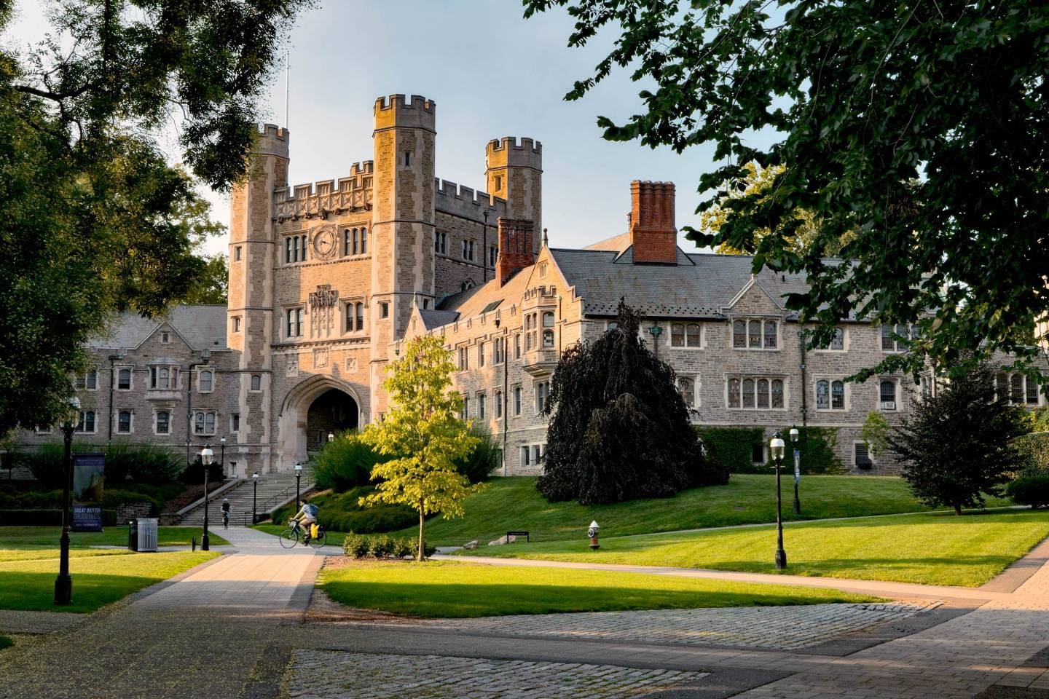
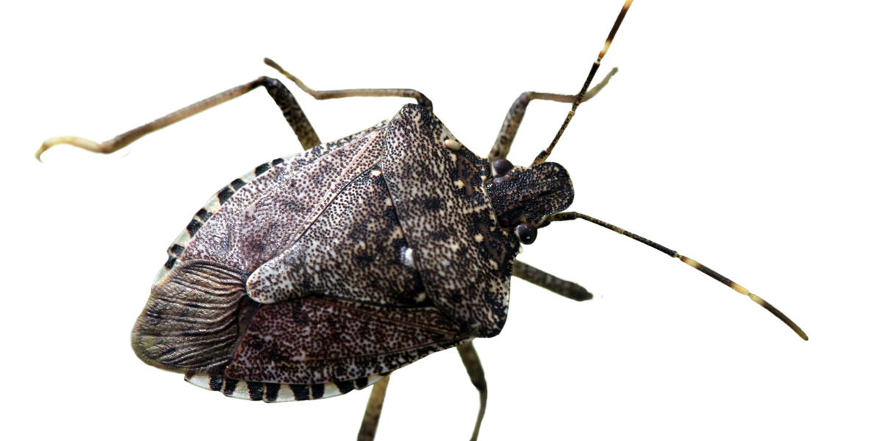


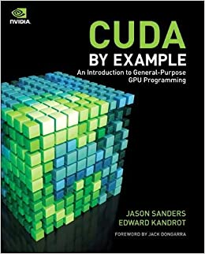
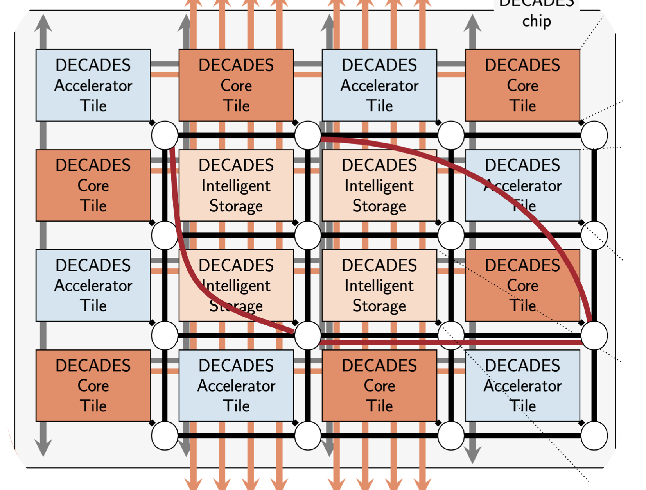
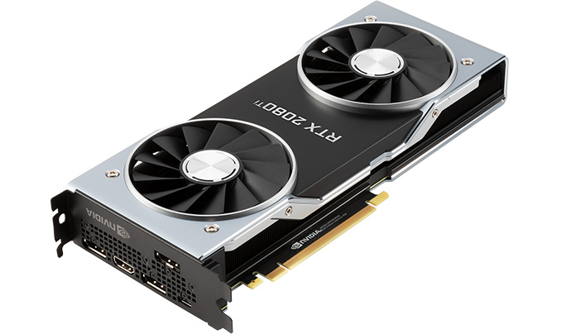
Research Interests
https://traveleering.com/ https://wikipedia.com https://Princeton.edu
MS: Utah
PhD: London
Post Doc: Princeton
Bugs in GPU programs
new parallel architectures
locks
barriers
on

Slide 4
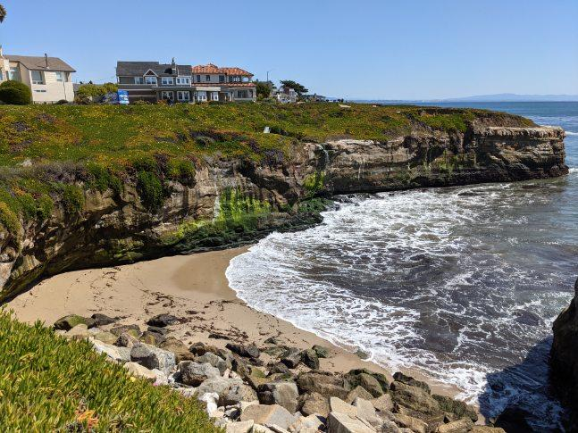

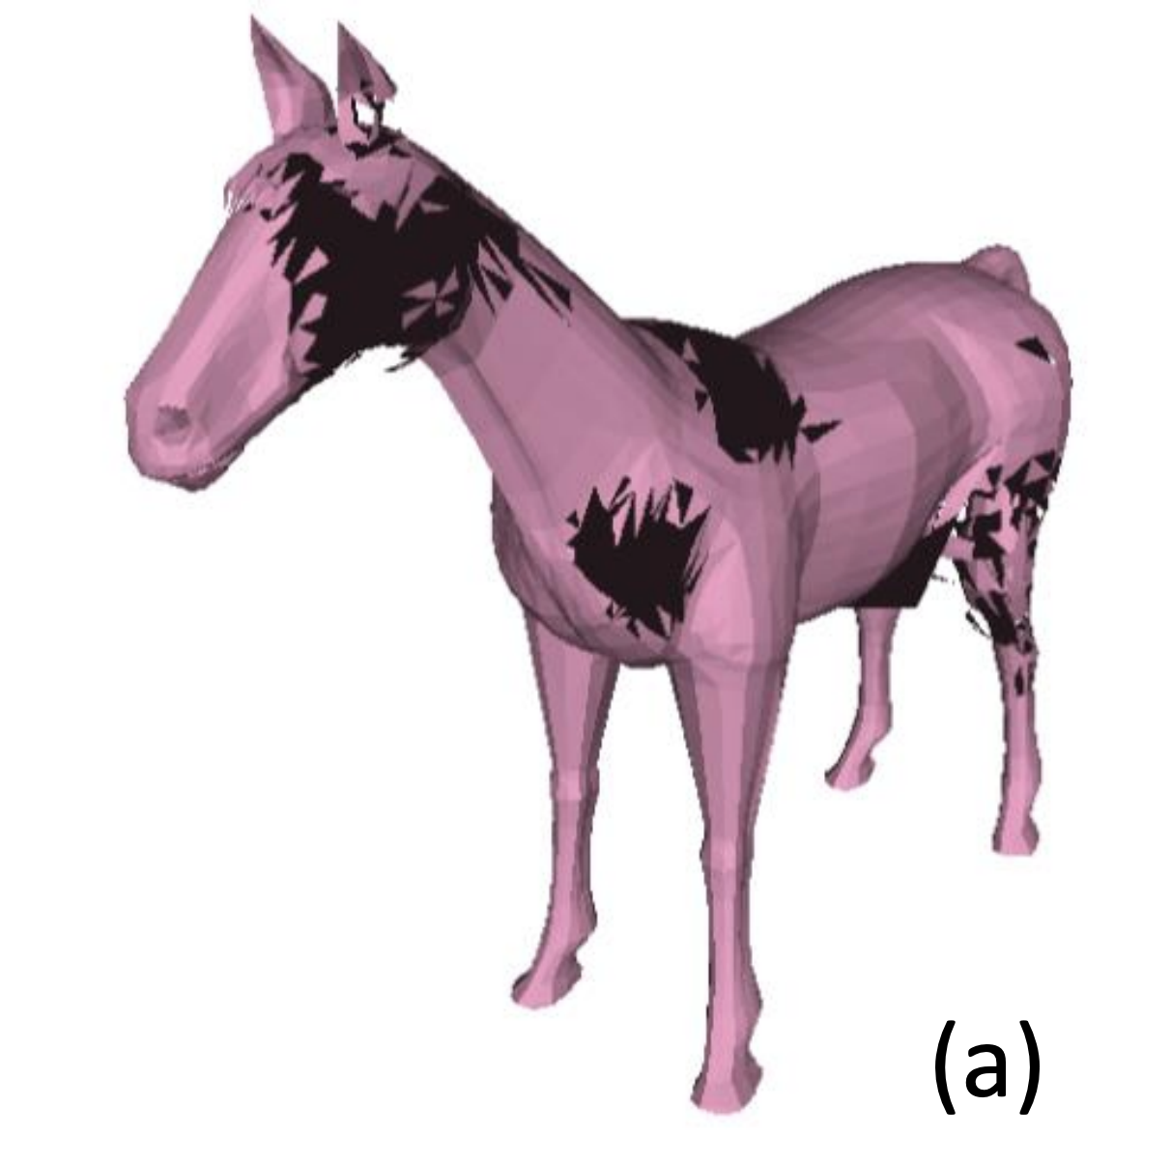
Research Interests
Faculty at UCSC
individual Contributor to
parallel particle simulations
GPU memory model testing

Slide 5
Research Interests
Parallel Programming!

Slide 6
Concurrency and Parallelism is everywhere!
Fujitsu SC at Riken (Japan)
Consumer Laptop
Mobile Phone
Watches?
7.6M cores
2-16 cores
2-8 cores
1 core
BUT
still need to worry about concurrency!
https://techwireasia.com/2020/06/japans-fugaku-is-the-worlds-fastest-supercomputer/ https://www.lenovo.com/
https://www.apple.com

Slide 7


Concurrency and Parallelism is everywhere!
In many cases you won’t know what hardware you are programming for
web apps
Android apps
You still need to worry about concurrency!
https://techwireasia.com/2020/06/japans-fugaku-is-the-worlds-fastest-supercomputer/ https://www.lenovo.com/
https://www.apple.com

Slide 8
Learning Objectives
Foundations of concurrent/parallel computing
Concepts, not languages/frameworks!
Allows you to pick up future new languages and frameworks quickly
Shared memory concurrency
Many concepts apply to other domains, but likely have different performance characteristics (e.g. distributed systems)
Thread cooperation, not embarrassingly parallel applications
Think in concurrency
understand common synchronization idioms and their performance characterizations
efficiently (and safely) utilize modern systems

Slide 9
Wall of text warning for today’s lecture!
Important to go over class organization and structure
You are responsible for knowing this information!
All information is also on the class website
If you have logistic questions, please refer to the website (or this lecture) first
Future lectures will be more visual

Slide 10
Today’s Schedule
Class Structure
Class Contents
Assignments, Tests, Grades
Special note on new AI tools

Slide 11
Déjà vu....
Starting the quarter off remote again 😅
Current guidance is that we will be remote for today and possibly tomorrow
We will follow campus guidance on class format, but it seems likely that it will go back to in-person in time for next lecture
This is not normal!
living conditions may have changed
uncertainty going forward
unrelenting disheartening news

Slide 12
We will persevere!
We will be:
We will be understanding and accommodating with each other
We will be kind to each other
We will be organized and communicate with each other
We will adapt
We will have:
a fun and productive quarter!

Slide 13
Class size
This is the largest that the class has ever been: 120 students!
We have lots of help:
3 grad TAs
3 undergrad graders/tutors
We will need lots of organization and structure to make it through the quarter smoothly.
We are developing a new class materials, structure, and frameworks to aid with scaling. I appreciate your understanding and patience if there are some growing pains

Slide 14
Teaching Staff Introductions
Grad TAs:
Reese Levine
PhD student working on GPU programming models with me
3rd time TA’ing this class
Jessica Dagostini
PhD student working with me and Prof. Beamer on HPC graph algorithms
Devon McKee
MS student working with me on GPU synchronization

Slide 15
Teaching Staff Introductions
Undergrad tutors and graders
Sanya Srivastava
2nd time tutoring this class
Kyle Little
working on a WebGPU project
Anish Pahilajani
Top student in class last year

Slide 16
Teaching Staff Introductions
They are all awesome! And they are passionate about parallel programming! Please utilize their office hours and tutoring as much as possible!
They will be your primary point of contact for technical help throughout the quarter

Slide 17
Class Resources
Public: https://sorensenucsc.github.io/CSE113-wi2023/index.html
Slides, schedule, resources
There are probably typos: please let me know!
Private: Canvas
Homeworks, grades, exams, announcements, recorded lectures, zoom links
Private Class forum:
Piazza - invite link incoming

Slide 18
Background
CSE 12: systems
C/++ programming
Compilation
Basic unix command line
CSE 101: data-structures and algorithms
Data structure specifications (Queues and Stacks)
Reasoning about algorithms (Space and time complexity)
CSE 120: architecture (recommended)
Caches
Assembly Language basics
We will review the basics next lecture
If you do not have architecture, please
consult the architecture reference on
webpage!

Slide 19
Class Format
9:20 - 10:25 MWF: 65 minutes
I will try to be 10 minutes early and stay 10 minutes afterwards
Class is generally structured as follows:
Announcements (homework assignments, etc.)
Quiz review
Previous lecture review
New material
Please be engaged and participate in class! questions, comments, corrections, etc. are all welcome!

Slide 20
Class format
Once things return to in-person (hopefully on Wednesday🤞)
This is an in-person synchronous class
I expect you to make an effort to attend the synchronous lecture
Please participate in class and network with your classmates

Slide 21
Class format
But don’t come to class sick!
I plan to record lectures and release through Yuja ASAP.
Watch the lecture and then do the associated quiz.

Slide 22
Class format
This class is designed to be a synchronous in-person class. Lecture recordings are not meant to be an equal substitute for live class. They are meant to fill in occasionally.
If you do not plan to attend the majority of the classes in-person, please talk to advising to find a class better suited for you.
Inevitably, students that do not attend lectures do not do as well in the class
If synchronous attendance drops significantly, then we will revisit attendance grading and lecture recordings.

Slide 23
Office Hours
My office hours:
3 - 5 PM on Thursdays
I will share a google sign up sheet (it will contain a zoom link)
Slots are 10 minutes
link will be posted in Canvas around noon that day
don’t sign up before the Canvas announcement
don’t sign up unless you have a question
sign up for 1 slot at a time
Strict with timing to make sure it is fair

Slide 24
Office Hours
The TAs and tutors will organize their office hours this week and we will let you know the days/times
We will strive to get a mix throughout the week and have both hybrid and in-person

Slide 25
Asynchronous Discussion
Piazza
Private message (to teaching staff) technical homework questions, sensitive questions
Programming and framework questions (global)
Tech news (global)
Discussions on class material (global)
Please do not email me personally unless it is extremely sensitive.
Do not expect replies off-hours (after 5 pm, weekends, holidays)
We will try to answer in 24 hours Please try to help your peers!

Slide 26
Asynchronous Discussion
Additional forums
You are welcome to create one yourselves
Please make it open and available to all your classmates
Please provide sufficient moderation (e.g. be nice to each other!)
Please do not cheat
Please remember that anything that is not in Canvas may not be private
If there are issues, please let me or a TA know!

Slide 27
Class Content

Slide 28

Class Content
30 classes, split into
5 modules, so there are
6 classes per module
Reference book:
Available online from the library
Link on the webpage
Book uses Java: we will use C++

Slide 29
Class Content
Module 1: Introduction, Background and ILP This module will provide an architectural refresher and discuss how modern hardware exploits parallelism within a thread (ILP). We will also introduce threading in C++.

Slide 30
Class Content
Module 2: Mutual Exclusion This module will discuss the fundamental problem of mutual exclusion. We will discuss the theory behind mutual exclusion, how it is implemented in practice, and specialized mutual exclusion objects.

Slide 31
Class Content
Module 3: Concurrent Data Structures This module will discuss concurrent objects and how to reason about them. We will discuss several implementations and discuss how it can be used in load balancing and software pipelining.

Slide 32
Class Content
Module 4: Reasoning about Concurrency This module will discuss how to reason about concurrent programs, including memory consistency and fairness.

Slide 33
Class Content
Module 5: Heterogenous Parallelism (GPGPU) This module will discuss heterogenous programming, with a focus on GPGPU programming. We will discuss the SIMT programming model, hierarchical execution, and different architectural considerations when optimizing programs.
I’m very excited for this module! We want to use a new platform (WebGPU) to allow everyone to program the GPUs on their own machines!

Slide 34
Class Content
Schedule:
https://sorensenucsc.github.io/CSE113-wi2023/schedule.html
Readings are highly recommended will be a useful reference for test studying and homeworks
Slides will be uploaded before lecture

Slide 35
Accessibility
UC Santa Cruz is committed to creating an academic environment that supports its diverse student body. If you are a student with a disability who requires accommodations to achieve equal access in this course, please submit your Accommodation Authorization Letter from the Disability Resource Center (DRC) to me by email, preferably within the first two weeks of the quarter. I would also like us to discuss ways we can ensure your full participation in the course. I encourage all students who may benefit from learning more about DRC services to contact DRC by phone at 831-459-2089 or by email at drc@ucsc.edu.

Slide 36
Assignments and Tests

Slide 37
Assignments and Tests
Assignments:
1 assignment per module
halfway through the module
due in 10 days
Each homework is worth 10% of your grade (total of 50%)
Do not expect replies off-hours (after 5 pm, weekends, holidays)
We will try to make homeworks due at midnight. If we receive too many questions off hours, we will move earlier (e.g., 8 PM)

Slide 38
Assignments and Tests
Format:
Coding assignments in C/++ and Python (and some Javascript for module 5)
We will provide a docker image that you should be able to run locally.
It is recommended that you have access to a machine with at least 4 cores!
If you do not, then our new format should be sufficient for you.

Slide 39
Assignments and Tests
Homework framework redesign planned (led by TAs).
We aim to use github classroom for submission and automatic feedback.
You will be graded on the server feedback rather than the results from your own machine. This is to help provide fair (and scalable) grading across the increasing diversity of devices that everyone has these days. Someone with an M1 processor will get very different results than someone with an Intel X86 processor.
There may be some friction getting started. We appreciate your patience and understanding. I will update the class as we make progress.
Ultimately this should be a big quality-of-life improvement for you!

Slide 40
Assignments and Tests
Architectural differences are very interesting to discuss and I hope we can have detailed discussions about how your machine’s results differ from the server on Piazza

Slide 41
Assignments and Tests
Two tests: Final and Midterm
We did asynchronous tests last year. Let’s plan on that again this year.
Designed to take ~180 minutes
As a warning: people take much longer on take-home tests than in-person tests!

Slide 42
Assignments and Tests
Midterm
Assigned halfway through module 3
One week
Assigned Feb 13, Due Feb 17
Designed to take 3 hours
Worth 10% of grade
Review slides and readings
Do not expect replies off-hours (after 5 pm, weekends, holidays)

Slide 43
Assignments and Tests
Final
1 Day (12 hours)
Assigned 8 AM on March 22
Due 8 PM on March 22
Designed to take 3 hours, we will monitor Piazza
Scheduled time is 4 PM to 7 PM (when we will be most active with help)
Worth 30% of grade
inclusive: slide material from all year, including readings

Slide 44
Assignments and Tests
What you can use for tests: You are free to consult notes, books, or the internet. While the test is active, you are not allowed to discuss the test with another person (either in the class or online). For example, you can google concepts that are on the test. You cannot post a test question to stackoverflow.
You are not allowed to use AI tools (github co-pilot or chatGPT). That will be considered cheating.
Please do not cheat! I like asynchronous tests but if we catch students cheating then I will have to move to synchronous tests!

Slide 45
Assignments and Tests
For assignments: I expect submitted assignments to contain your own original work. You can refer to notes, slides, internet, etc. But do not blindly copy code.
Any part of your submission that is not your original work (e.g. code snippets from the internet) need a citation. My aim is to be lenient with cited code, but we may remove some points based on the extent. A few missing points is better than a referral for academic misconduct.
I prefer that you do not collaborate on homework with classmates. In the case that you do, please mention in the submission. Again, a few missing points is better than a misconduct referral.

Slide 46
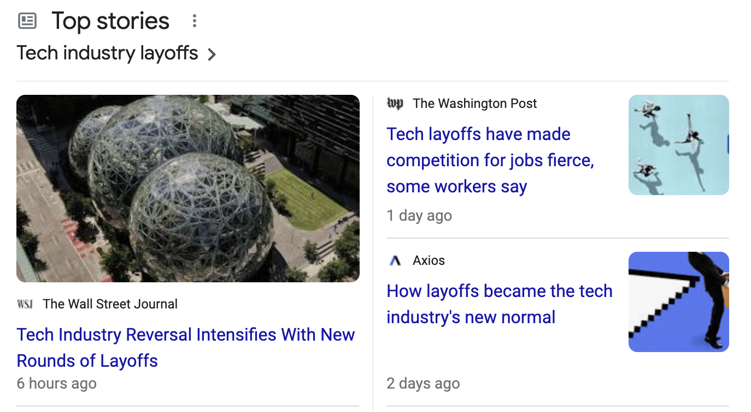
Cheating
This class has a zero tolerance policy on cheating. Please don’t do it. I would much rather get a hundred emails asking for help than have to refer anyone for academic misconduct.
Cheating harms you: this is the best chance in your career to take the time to really learn the class material. If you do not learn the material you will not be successful in a tech career.
The current economic conditions are volatile for computer science graduates. You will not stand out to a company for having straight As. You will stand out if you can show a deep understanding of complicated CS topics. When you cheat, you deprive yourself of this learning.

Slide 47
Discussing results
You cannot share code snippets or discuss coding solutions at a low-level.
However, unless otherwise specified: in the second week of the assignment, you can share local (from your own machine) results with your classmates.
You will have different machines and thus, your results may not align completely: it is interesting to think about why!

Slide 48
AI Tools
Exciting time for AI:
Github co-pilot
ChatGPT
Impact on learning objectives is not clear.
This class has been designed to be taken without the use of AI tools.
If you use them for your assignments (or especially tests), it will be considered academic misconduct. To be clear: it is not acceptable to use the tools and modify the AI output. Just do not use the tools at all when doing coursework for this class.

Slide 49
AI Tools
However, I will provide the following option to you (only for the homeworks):
after you have completed the assignment, you can use the AI tools to see how they could help solve the problem.
Please submit a non-AI version of the assignment first.
Afterwards, try to use the AI tools. Write several paragraphs explaining how you approached the tools, what prompts you used, what the tools suggested, and if the tools were correct or incorrect.
Submitting this extra report can provide up to 5 points extra credit (not to exceed 100%) on each homework assignment. There is no rubric for the extra credit and points will be given at our discretion.

Slide 50
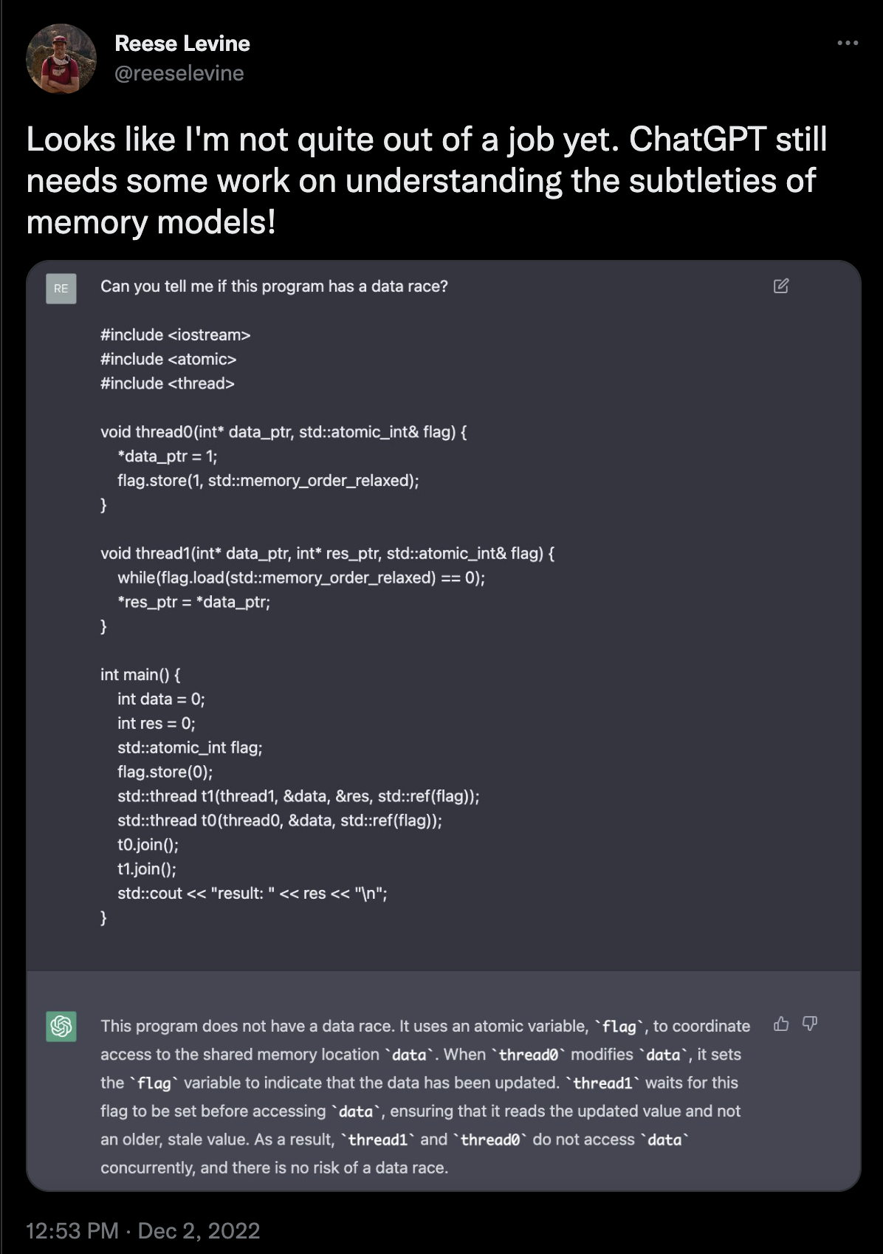
AI Tools

Slide 51
Late policy
Assignments:
You have 10 days to submit each assignment.
Each assignment has 4 days that you can turn in the assignment late with no penalty.
No work accepted after the 4 days.
Tests:
Will not be accepted late. No exceptions

Slide 52
Reviewing Grades
For assignments and tests:
You have 1 week from when the grade is posted to discuss grades with teaching staff

Slide 53
Assignments and Tests
Grade Breakdown:
5 homeworks: 50%
1 midterm: 10%
1 final: 30%
attendance/quiz: 10%

Slide 54
Attendance and Quizzes
Small canvas “quiz” every lecture - take the quiz to get the daily points
Quiz answers are not graded! only if you submit it
However, low-effort quiz submissions are liable to be failed.
Quizzes are posted after class and due before the next class
Some quiz questions do not have a right or wrong answer. They are meant to make you think about the material!

Slide 55
Attendance and Quizzes
You can miss up to 3 quizzes without penalty.
Only submit the quiz once you have watched the lecture (either in person or remotely)! if you do not watch the lecture and submit the quiz, it is considered a breach of academic integrity.

Slide 56
Website tour

Slide 57
Final notes
This class is still “new”
Material is still being developed, especially at this scale
There may be issues on HWs and tests (please let us know if you find any!)
There may be schedule changes
We will do our best and make sure to stay organized and communicate clearly!

Slide 58
Thank you!
It’s a risk taking a new class like this. Thank you for giving it a chance!
Your experiences and feedback will help shape this class for future students.
Email is always open for comments about class material, HW assignments, etc.

Slide 59
Next Class
Architecture/Compiler review:
Why?
Parallel programming lives at the edge of the software/hardware interface. We will need to understand architecture/compiler basics in order to program efficient and correct programs
Good programming languages for parallel architectures is still an open problem!!

